Slide 1
Chapter 3: Operating-System Structures
An OS provides the environment within which programs are executed.
There are several vantage points to view OSs.
  Functional view (what it does)
  Components view (Designers view)
  Services view (Users/Programmers view)
  Structure view (How it is implemented)

Slide 2
Functional view
Program execution and handling
  Starting programs, managing their execution and communicating their results.
I/O operations
  Mechanisms for initiating and managing I/O
File-system Management
  Creating, maintaining and manipulating files
Communications
  Between processes of the same user
    Such as sending result of input request to a user program
  Between different users
Exception detection and handling
  Protection related issues
  Safety in the case of power failures via backups.
  Detecting undesirable state such as printers out of paper.

Slide 3
Functional view (…)
Resource allocation
  Includes processor and I/O scheduling, memory management
Accounting
  To track users usage of resources for billing and statistical reasons
Protection
  Maintaining integrity of user’s data
  Integrity checks to keep out unauthorized users
  Maintaining logs of incorrect attempts

Slide 4
Components view
Processes
Storage
I/O
  Devices
  files
Protection
  Users

Slide 5
Component view: Processes
A process is
  Dynamic entity created by the execution of the program.
  Typically program + run time control information.
    Control information includes memory maps, program counter value etc.
    May also have a context information.
  OS attempts treat all processes uniformly.
Processes may play different roles
  User processes
  OS (system) processes
A single process can spawn other processes
  A computation requires typically many processes
    Shell, one or more user processes, one or more system processes

Slide 6
Component view: Process management
Operations:
  Creation and termination
  Suspension and resumption
    Due to interrupts, context switches
  Synchronizing processes
    Making sure that a process that is waiting on an I/O waits till it is completed and does not wait forever, i.e., wakes-up soon after an I/O process terminates.
  Communication
    Between two processes enabling them to cooperate.
  Deadlock detection and avoidance.

Slide 7
Component view: Storage management
Managing main memory
  Allocating main memory to active processes
    Maintaining a map of allocated vs. free memory
  De-allocating currently used memory to make a room for other processes.
Managing secondary storage
  Managing the free sectors/tracks on the disk
  Allocating this storage to programs
  Scheduling access requests to the disk

Slide 8
Component view: I/O management
Devices
  Device drivers
  Accepting an I/O request and invoking appropriate device driver
Files
  Non-volatile representation of users/system programs and data.
  File systems
    Support logical organization of data that the user might want to see
    Map data onto the physical storage devices and orchestrate their access and update.
  Operations
    Creation, manipulation and deletion of files and directories
    Moving files from primary to secondary storage while maintaining structure.
    Interaction with the memory manager
    Backup and protection

Slide 9
Component view: Protection
Controlling the access of programs, processes, or users to the resources defined by the computer system.
  Specification and enforcement

Slide 10
Services view
Command interpreter
Two levels of specification
  System calls
    The interfaces in which the processes invoke specific OS functions
  System programs
    May use capabilities not available through system calls
  The interfaces at these levels can be standardized.
    e.g network protocols, etc.

Slide 11
Services view: Command interpreters
Interface between the user and the OS
Can be a part of kernel or a separate process (shell)
Striking differences between OSs
  Ranges from GUIs to cryptic control card interpreters.
Typical commands
  Process creation and destruction
  I/O handling and file system manipulation
  Communication: interact with remote devices
  Protection management: changing file/directory access control.

Slide 12
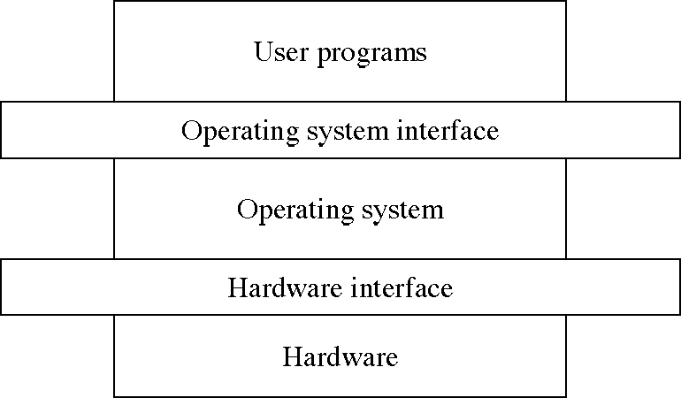
The OS Level Structure
(Current chapter)
(To be studied)
(Completed)

Slide 13
System calls
A special machine instruction
  that causes an interrupt
  various names: syscall, trap, svc
Usually not generated by HLLs
  but in assembly language functions
The system calls are the instruction set of the OS virtual processor.

Slide 14
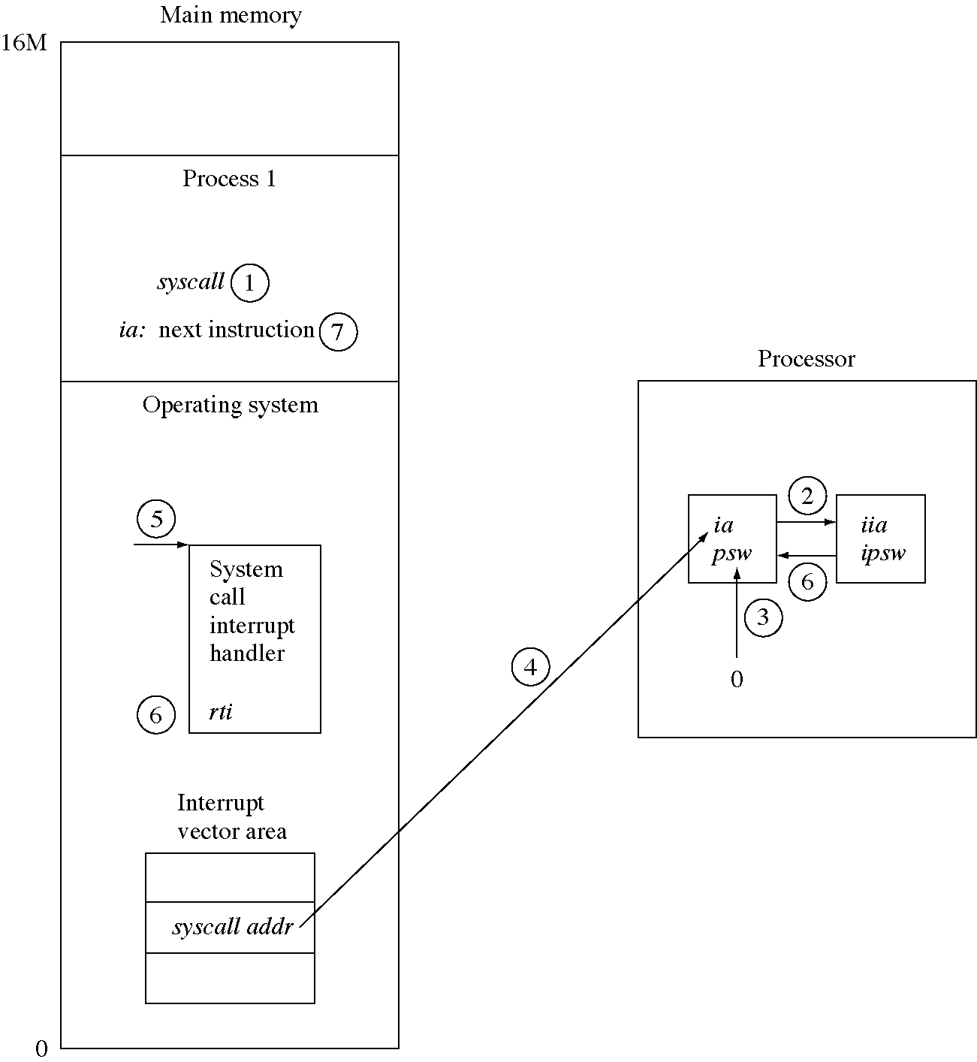
System call flow of control
Program Executes System call
The hardware saves current ia (instruction address register) and psw in the iia (interrupt instruction address register) and ipsw (interrupt program status word) registers
The hardware converts puts 0 in PSW and interrupts are disabled.
The hardware loads the ia register with system call interrupt vector
Instruction execution continues at the beginning of interrupt handler.
The The system call handler completes and executes a return from interrupt instruction. This restores the ia and psw from iia and ipsw.
The process that executed the system call instruction continues at the instruction after the system call.

Slide 15
Services view: System Calls
Interface between a process and OS
  Arguments typically passed through registers, a memory block or on stack.
Process job control
  load, execute, end, abort, create/terminate
  get and set process attributes (priorities and allowable execution times)
  Wait for time/event, signal event, allocate memory
File manipulation
  create/delete, open/close, read/write, reposition
  get/set file attributes (protection parameters, locations in directories,…)
Device manipulation
  Same set of calls as above (devices are treated as files)
Information maintenance
  Get/set system data (time, memory/CPU usage), process and device attributes
Communications
  Create/delete links, send and receive messages
  Transfer status information
  Modes can be message passing or shared memory

Slide 16

Passing of Parameters As A Table

Slide 17
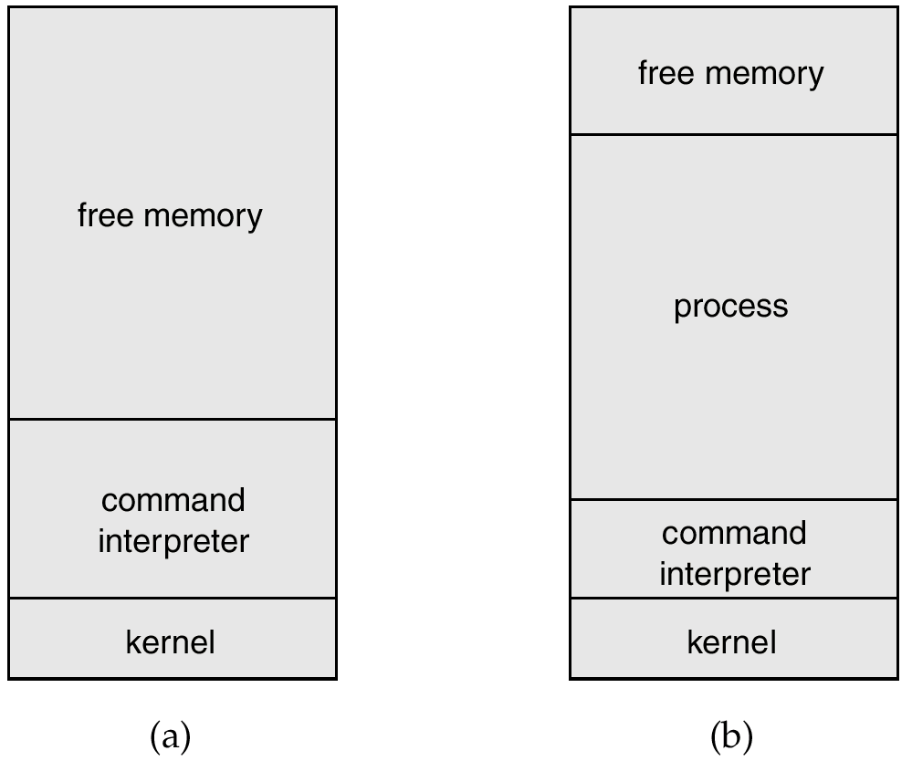
MS-DOS Execution
At System Start-up
Running a Program

Slide 18
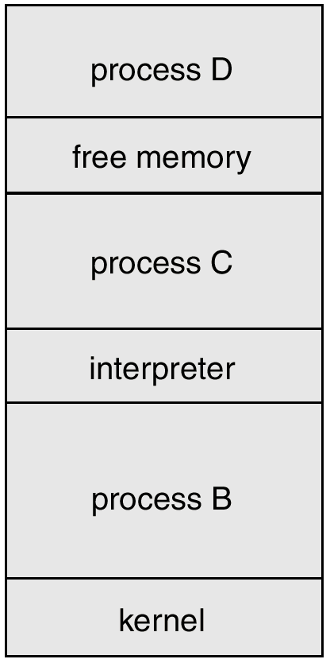
UNIX Running Multiple Programs

Slide 19

Communication Models
Communication may take place using either message passing or shared memory.
Msg Passing
Shared Memory

Slide 20
Services view: System Programs
Each system call is usually supported by a system program.
  File/directory manipulation: create, delete, copy name, print, dump, list
  Status information: Programs that ask system information and display to users.
  File modification: Text editor programs
  Command interpreter
  Programming language support
    Compilers, assemblers, debuggers
  Loaders and linkers
    For enabling the execution of programs that start new processes and connect different ones.
  Application programs
    Text processing software, graphics support, spread sheets, games

Slide 21
Structure view
OS is a complex program and should be engineered carefully
Divide into components with carefully defined inputs, outputs and functions.
How to structure OS functionality ?
  Layering
  Virtual machines
Designing and implementation of OS.

Slide 22
MS-DOS System Structure
MS-DOS – written to provide the most functionality in the least space
  not divided into modules
  Although MS-DOS has some structure, its interfaces and levels of functionality are not well separated
  The designers of MSDOS had no idea that it would become popular.
  Limited hardware and space.
  Application programs are able to access basic I/O routines to write correctly to the display and disk writes.
  MSDOS is vulnerable to errant (or malicious) programs

Slide 23

MS-DOS Layer Structure

Slide 24
OS design hierarchy: hypothetical model
Level | Name | Objects | Example operations
13 | Shell | User programming environment | Statements in shell language
12 | User programs | User processes | Quit, Kill, suspend
11 | Directories (maintains association between external and internal identifiers of system resources and objects) | Directories | Create, destroy, search, list, access rights
10 | Devices (access to external devices) | Printers, displays, and key boards | Create, destroy, open, close
9 | File system (long storage of named files) | files | Create, destroy, open, close
8 | Communications | pipes | Create, destroy, open, close, read, write
7 | Virtual memory (creating logical address space for programs) | Segments, pages | Read, write, fetch
6 | Local secondary storage (position of read/write heads) | Blocks of data, device channels | Read, write, allocate, free
5 | Primitive processes | Primitive process, semaphores, synchronization premitives | Suspend, resume, wait, signal
4 | Interrupts | Interrupts handling programs | Invoke, mask, unmask, retry
3 | Procedures | Procedures, call stack | Mark stack, call, return
2 | Instruction set | Evaluation, stack, micro-program, interpreter | Load, store, add, subtract, branch
1 | Electronic circuits | Registers, gates, busses | Clear, transfer, activate, complement

Slide 25
Pipe and shell
A pipe is defined with its output from one process and its input into another process.
Shell provides simply as a collection of services
The shell accepts user commands or job control statements, interprets these and creates and controls processes.

Slide 26
Structure view: Structure of OS designs
Traditionally adhoc and unstructured approaches.
Structured designs
  Layered approach is followed to realize modularity
  Encapsulate the modules separately
  Have a hierarchy of layers where each layer calls procedures from the layers below.
The THE OS (Dijkstra)
  Layer 0 : Hardware
  Layer 1: CPU scheduler
  Layer 2: Memory manager
  Layer 3: Operator-console device driver
  Layer 4: I/O buffering
  Layer 5: user program layer
The VENUS OS (Liskov)
  Layer 0 : Hardware
  Layer 1: Instruction interpreter
  Layer 2: CPU scheduler
  Layer 3: I/O channel
  Layer 4: Virtual memory
  Layer 5: device drivers and schedulers
  Layer 6: user program layer

Slide 27
Structure view: layered system design
A general philosophy that builds on the above approach
  Decompose functionality into layers such that
    Hardware is level 0, and layer t accesses functionality at layer (t-1) or less
    Access via appropriately defined system calls.
Advantages
  Modular design: well defined interfaces between layers
  Prototyping/development
    Association between function and layer eases overall OS design.
    OS development and debugging is layer by layer.
    Simplifies debugging and system verification
New
operations
Layer M
Hidden
operations
Layer
M-1
Existing
operations

Slide 28
Structure view: layered system design…
Disadvantages
  Substantial design time since layers have to be designed carefully
  Crossing multiple layers (of system calls) leads to inefficiency
  An I/O request by the user has to pass each layer (I/O layer, CPU scheduling layer, hardware layer)
  Each layer adds overhead to the system
  OSs are not naturally hierarchical
  Two layers (micro kernel and one more) approaches are successful.
  Example: WINDOWS NT
    First release had a layered architecture
    But performance was low over WINDOWS98
    Performance was improved by integrating some of the layers in WINDOWS4.0
New
operations
Layer M
Hidden
operations
Layer
M-1
Existing
operations

Slide 29
UNIX System Structure
UNIX – limited by hardware functionality, the original UNIX operating system had limited structuring. The UNIX OS consists of two separable parts.
  Systems programs
  The kernel
    Consists of everything below the system-call interface and above the physical hardware
    Provides the file system, CPU scheduling, memory management, and other operating-system functions; a large number of functions for one level.
Shell editors
Compiler
Assembler
loader
kernel
Compiler
components
Application
programs
Hardware
Private user programs

Slide 30

UNIX System Structure

Slide 31
Shell: an OS interface
Interactive access to the OS system calls
  copy fromFile toFile
Contains a simple programming language
Popularized by UNIX
  Before UNIX: JCL, OS CLs (command languages)
  Bourne shell, C shell (csh), Korn shell (ksh), Bourne-again shell (bash), etc.

Slide 32
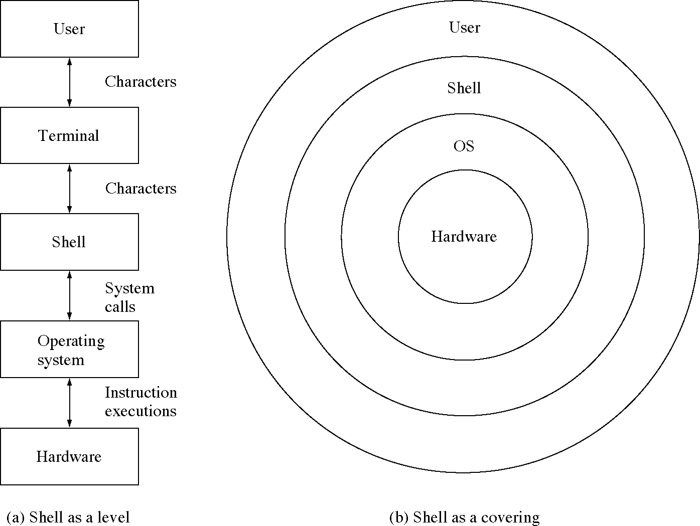
Two views of a shell

Slide 33
Structure view: Virtual machines
System programs above kernel can use either system calls or hardware instructions.
System programs treat the hardware and the system calls as though they both are at the same level.
In general application programs may view everything under them in the hierarchy as a part of machine itself, which leads to the concept of virtual machines..
The virtual machine approach provides an interface that is identical to the underlying bare hardware.
Each process is provided with a (virtual) copy of the underlying computer.
The resources of the physical computer are shared to create the virtual machines.
  CPU scheduling and spooling are used.

Slide 34
Structure view: Virtual machines
Logical conclusion of layered approach.
  The OS offers an abstract machine to execute on
    Hides the specifics and details of hardware
  Users are given their own VM, they can run any of the OS or software packages that are available on the underlying machine.
  Provides a complete copy of underlying machine to the user
    Pioneered under the name virtual machine (VM) by IBM
    Became a household name with JAVA
Mechanism of creating this illusion
  CPU scheduling
    Sharing the CPU in a transparent way
  Memory management
    Having large virtual memory space to address
  Additional features such as file systems and so on are offered through file management subsystems
    Problem is with partitioning the disk
      VM introduced minidisks such partitioning of tracks on the physical disk.

Slide 35
Types of multiplexing
Time multiplexing
  time-sharing
  scheduling a serially-reusable resource among several users
Space multiplexing
  space-sharing
  dividing a multiple-use resource up among several users

Slide 36
Virtual computers
Processor virtualized to processes
  mainly time-multiplexing
Memory virtualized to address spaces
  space and time multiplexing
Disks virtualized to files
  space-multiplexing
  transforming

Slide 37
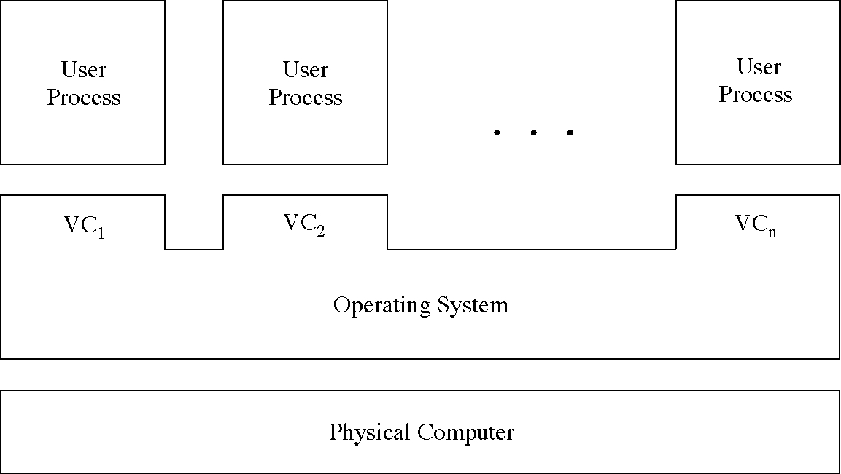
Multiple virtual computers

Slide 38
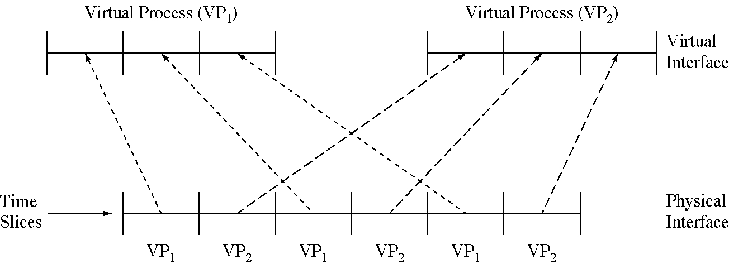
Time-multiplexing the processor

Slide 39
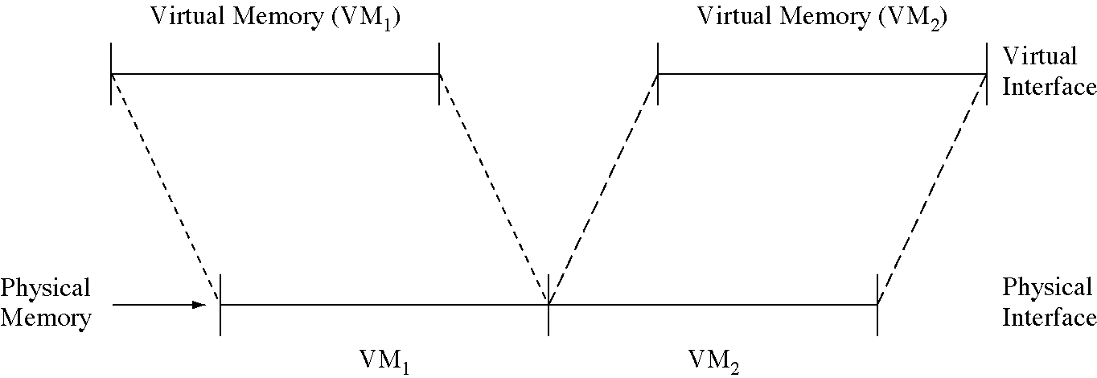
Space-multiplexing memory

Slide 40
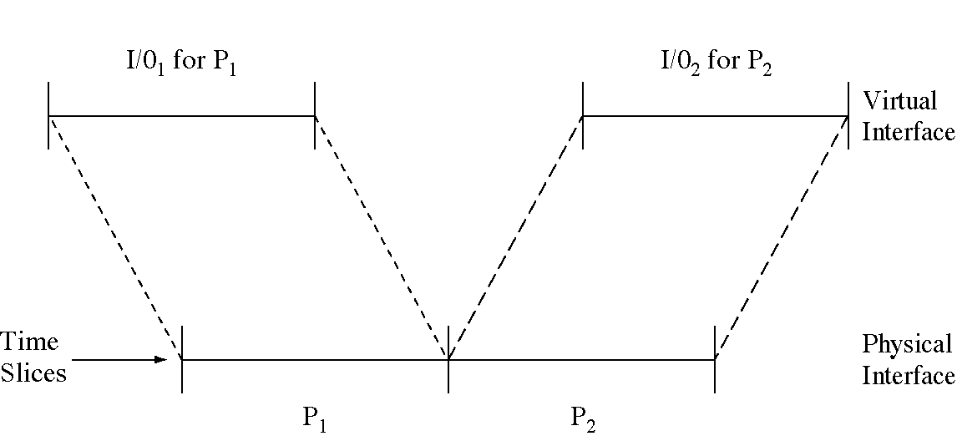
Time-multiplexing I/O devices

Slide 41
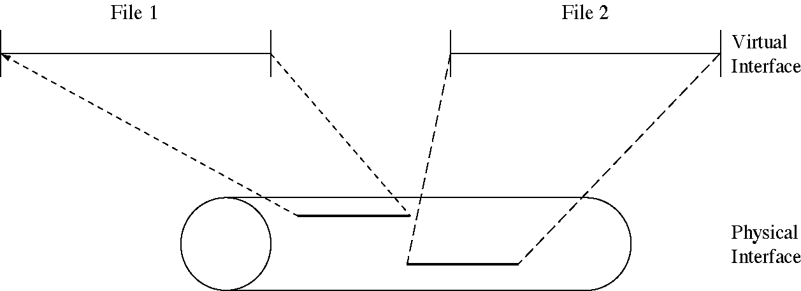
Space-multiplexing the disk

Slide 42

System Models
Non-virtual Machine
Virtual Machine

Slide 43
Structure view: Virtual machines (cont..)
Operation
  User-level code executes as is
  Supervisor code executes at user level
    Privileged instructions are simulated.
      Generate trap to VM emulator
    Hidden registers and I/O instructions are simulated.
  Virtual machine software has two modes
    User mode and monitor mode
  The user program will execute in two modes
    Virtual user mode
    Virtual monitor mode

Slide 44
Structure view: Virtual machines (cont..)
Advantages
  A software created abstraction that is a replica of the underlying machine
  Additional functionality can be provided
    Can run different OSs on different VMs.
  Each VM is completely isolated from others, so secure.
  Protection of various system resources.
  It can be used for OS research and development.
  System programs are given their own virtual machine.
  Thousands of programs are available for MSDOS on Intel CPU-based systems.
  SUN micro-systems and DEC use faster machines
    To test MSDOS programs on the faster machines, the best way is to provide a virtual Intel machine.
  System compatibility problems can be solved
Disadvantages
  Performance degradation is inevitable

Slide 45
JAVA
JAVA is designed by SUN Micro systems.
JAVA compiler generates byte code output.
These instructions run on Java virtual machine.
JVM runs on many types of computer.
JVM is implemented in web browsers.
JVM implements a stack based instruction set.

Slide 46
System Design and Implementation
:design goals
First problem is defining the goals
  Batch, time-shared, single-user, multi-user, distributed, real-time, or general purpose.
The goals can be divided into two parts: user goals and system goals
  Users: Convenient to use, easy to learn, easy to use, reliable, safe, and fast.
  System goals: easy to design, create, maintain, and operate. It should be flexible, reliable, and error-free.
Software engineering principles can be applied for deciding goals.

Slide 47
Mechanisms and policies
The specification and design of OS is highly creative task.
One important principle is separation of policy and mechanism.
Mechanisms describe how things are done
  The function of CPU scheduling is an example
  For CPU protection, timer will be used.
  Does not include decisions as to which process gets priority
Policies describe what will be done
  Deciding whether processes with more I/O get priority over CPU bound processes is an example
  This policy can be a input parameter and can change from scheduler to scheduler
  For CPU protection, how long the timer is set is a policy decision.
Micro-kernel OSs only implement mechanisms. Policies are provided at user level

Slide 48
Implementation
Assembly language can be used.
  High speed
High level language
  Easy to develop, easy to understand and debug, easy to port.
  UNIX was written in C.
  Dis adv: reduced speed and increased storage requirements.
  We have sophisticated compilers.

Slide 49
System generation (SYSGEN)
The OS program is normally distributed on disk or tape.
A special program SYSGEN reads from a given file and asks the operator regarding specific configuration of the system.
  Probes the hardware directly to determine what components are there.
Regenerate/Configure the OS for new machine parameters
  CPU type
  Machine parameters include
    Memory size, I/O device parameters, address maps etc.
    Mechanisms describe how things are done
  Devices
  Options of OS
    CPU scheduling algorithm, buffer size.
Approaches
  Recompile
  Have precompiled parameterized libraries: link rather than compiling
  Use table driven run-time selection

